Slide 1
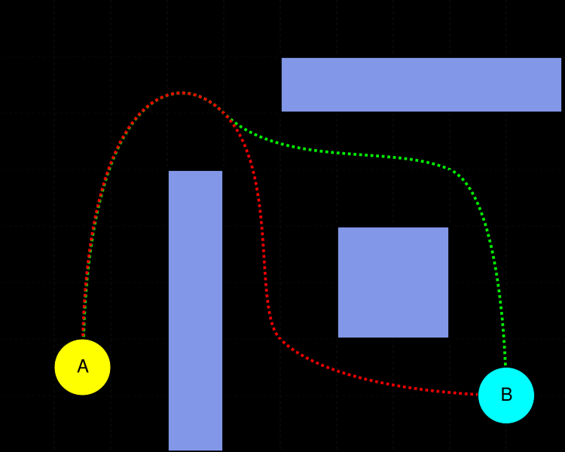
VGP332 – Artificial Intelligence
Instructor: Peter Chan

Slide 2
Agenda
Assignment 1 Redux
Review
Dijkstra’s Algorithm
A* Algorithm
Graph Search Improvements
Alternative Graph Searches
Assignment 2 Overview

Slide 3
Agenda
Assignment 1 Redux
Review
Dijkstra’s Algorithm
A* Algorithm
Graph Search Improvements
Alternative Graph Searches
Assignment 2 Overview

Slide 4

Assignment 1 Redux
Questions?

Slide 5
Agenda
Assignment 1 Redux
Review
Dijkstra’s Algorithm
A* Algorithm
Graph Search Improvements
Alternative Graph Searches
Assignment 2 Overview

Slide 6
Review
What is pathfinding?
What can graphs be used for?
How can you implement graphs?

Slide 7
Graph Searches
Open list:
  list of nodes you need to consider in the steps ahead
Closed list:
  list of nodes you’ve already visited and don’t need to consider again

Slide 8
Graph Searches
put start node in open list
while end node not reached && open list isn’t empty:
move node N from open list to closed list
expand node N:
if expanded node isn’t in open or closed lists:
add expanded node to open list

Slide 9
DFS, BFS
DFS:
Choose node from front of open list
Expanded nodes get added to front of open list
BFS:
Choose node from front of open list
Expanded nodes get added to back of open list

Slide 10
Agenda
Assignment 1 Redux
Review
Dijkstra’s Algorithm
A* Algorithm
Graph Search Improvements
Alternative Graph Searches
Assignment 2 Overview

Slide 11
Shortest Paths
What is the shortest path between two nodes on a graph?

Slide 12
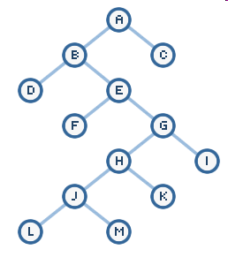
Shortest Paths
Consider this graph:

Slide 13
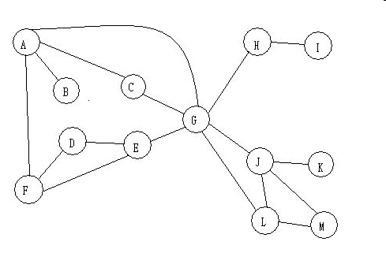
Shortest Paths
Consider this graph:

Slide 14
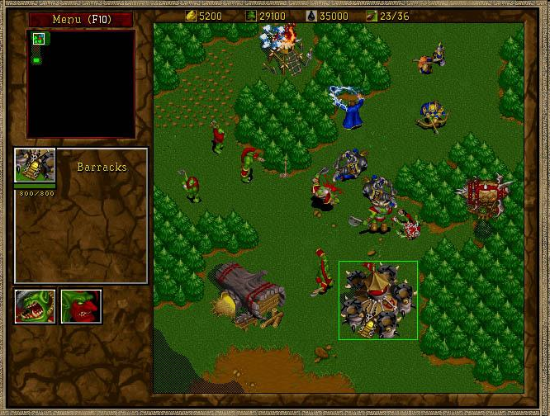
Shortest Paths
Consider this map:

Slide 15
Dijkstra’s Algorithm
Choose node from front of open list that is the shortest cumulative distance from the starting node
Expanded nodes get added to front of open list

Slide 16
Dijkstra’s Algorithm
Choose node from front of open list that is the shortest cumulative distance from the starting node
Expanded nodes get added to front of open list
This is called a cost function

Slide 17
Dijkstra’s Algorithm
Cost function
f(x) = g(x)
where g(x) is shortest distance traveled from initial node to current node

Slide 18
Dijkstra’s Algorithm
http://en.wikipedia.org/wiki/Dijkstra_algorithm

Slide 19
Dijkstra’s Search Applet
Try this out:
http://www-b2.is.tokushima-u.ac.jp/~ikeda/suuri/dijkstra/Dijkstra.shtml

Slide 20
Dijkstra’s Search on Grid-Based
A B C D E
1
2
3
4
5
S |  |  |  | E

Slide 21

Observations on Dijkstra’s Search
Pros?
Cons?
Results?

Slide 22
Observations on Dijkstra’s Search
Optimal
Informed

Slide 23
Agenda
Assignment 1 Redux
Review
Dijkstra’s Algorithm
A* Algorithm
Graph Search Improvements
Alternative Graph Searches
Assignment 2 Overview

Slide 24
A* Algorithm
Choose node from front of open list that is on the shortest path from the starting node to the ending node
Expanded nodes get added to front of open list

Slide 25
A* Algorithm
Choose node from front of open list that is on the shortest path from the starting node to the ending node
Expanded nodes get added to front of open list
Anything odd about this cost function?

Slide 26
A* Algorithm
Q: If you’re searching for a path but haven’t found one yet, how can you know how long the full path is?

Slide 27
A* Algorithm
Q: If you’re searching for a path but haven’t found one yet, how can you know how long the full path is?
A: Make an informed guess

Slide 28
A* Algorithm
A
R
h
g
B
f
For any path you’re considering from A to B
  Suppose you’re as far along as node R
  You know how far you’ve come: distance = g
  Best case from R to B: distance = h

Slide 29
A* Algorithm
Cost function
f(x) = g(x) + h(x)
where g(x) is shortest distance traveled from initial node to current node
and h(x) is the guessed distance from the current node to the end node

Slide 30
A* Algorithm
http://en.wikipedia.org/wiki/A-star_algorithm

Slide 31
A* Search on Grid-Based
A B C D E
1
2
3
4
5
S |  |  |  | E

Slide 32
A* Search Applet
Try this out:
http://www.vision.ee.ethz.ch/~cvcourse/astar/AStar.html

Slide 33
Observations on A* Search
Pros?
Cons?
Results?

Slide 34
Observations on A* Search
Optimal
Informed
h(x) needs to be admissible
This means that the estimate must be less than or equal to the actual lowest cost

Slide 35
A* Search Heuristics
Can you think of other heuristics to use?

Slide 36
Search Algorithm Comparison
Try this out:
http://www.stefan-baur.de/cs.web.mashup.pathfinding.html

Slide 37
Agenda
Assignment 1 Redux
Review
Dijkstra’s Algorithm
A* Algorithm
Graph Search Improvements
Alternative Graph Searches
Assignment 2 Overview

Slide 38
Graph Search Improvements
What improvements can you think of for:
  BFS
  DFS
  Dijkstra’s
  A*

Slide 39
Agenda
Assignment 1 Redux
Review
Dijkstra’s Algorithm
A* Algorithm
Graph Search Improvements
Alternative Graph Searches
Assignment 2 Overview

Slide 40
“Best-first” search
Favour paths that would lead towards the goal
E.g.
Can combine with A* search’s cost function
Start
Which search directions are preferable in this case?
End

Slide 41
Minimax Search
Usually used in turn-based two-player games
Scoring function evaluates board/moves
Create branching tree of move possibilities
Maximize AI’s move and minimize opponent’s move
http://wolfey.110mb.com/GameVisual/launch.php

Slide 42
Alpha-beta pruning
Optimization for minimax searches
Prune (don’t generate/evaluate) unnecessary branches

Slide 43
Minimax & Alpha-Beta Example
Petri
Blob Wars

Slide 44
Agenda
Assignment 1 Redux
Review
Dijkstra’s Algorithm
A* Algorithm
Graph Search Improvements
Alternative Graph Searches
Assignment 2 Overview

